Slide 1
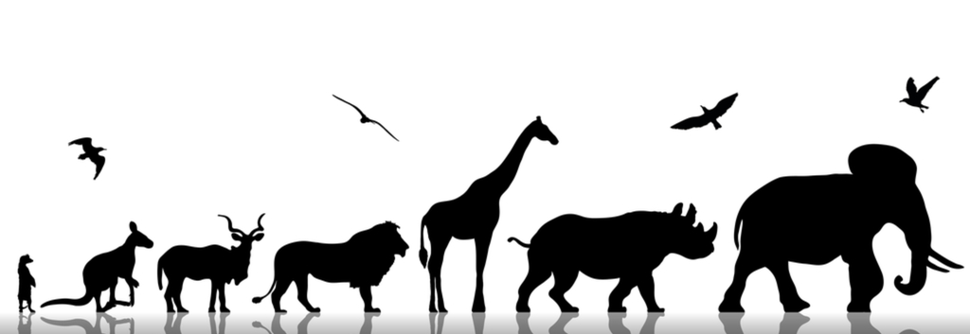
Animalia kingdom
A model to predict if a species is endangered or conserved
Maria Arsky & Niv Bar

Slide 2
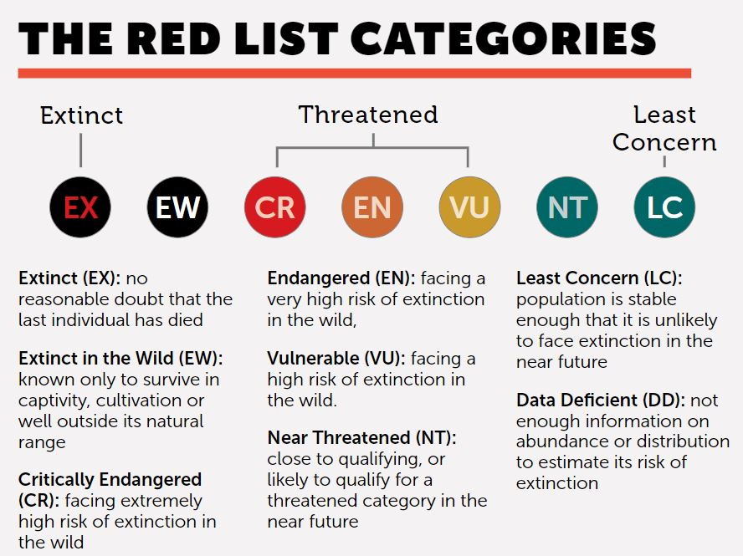
Endangered
Conserved

Slide 3
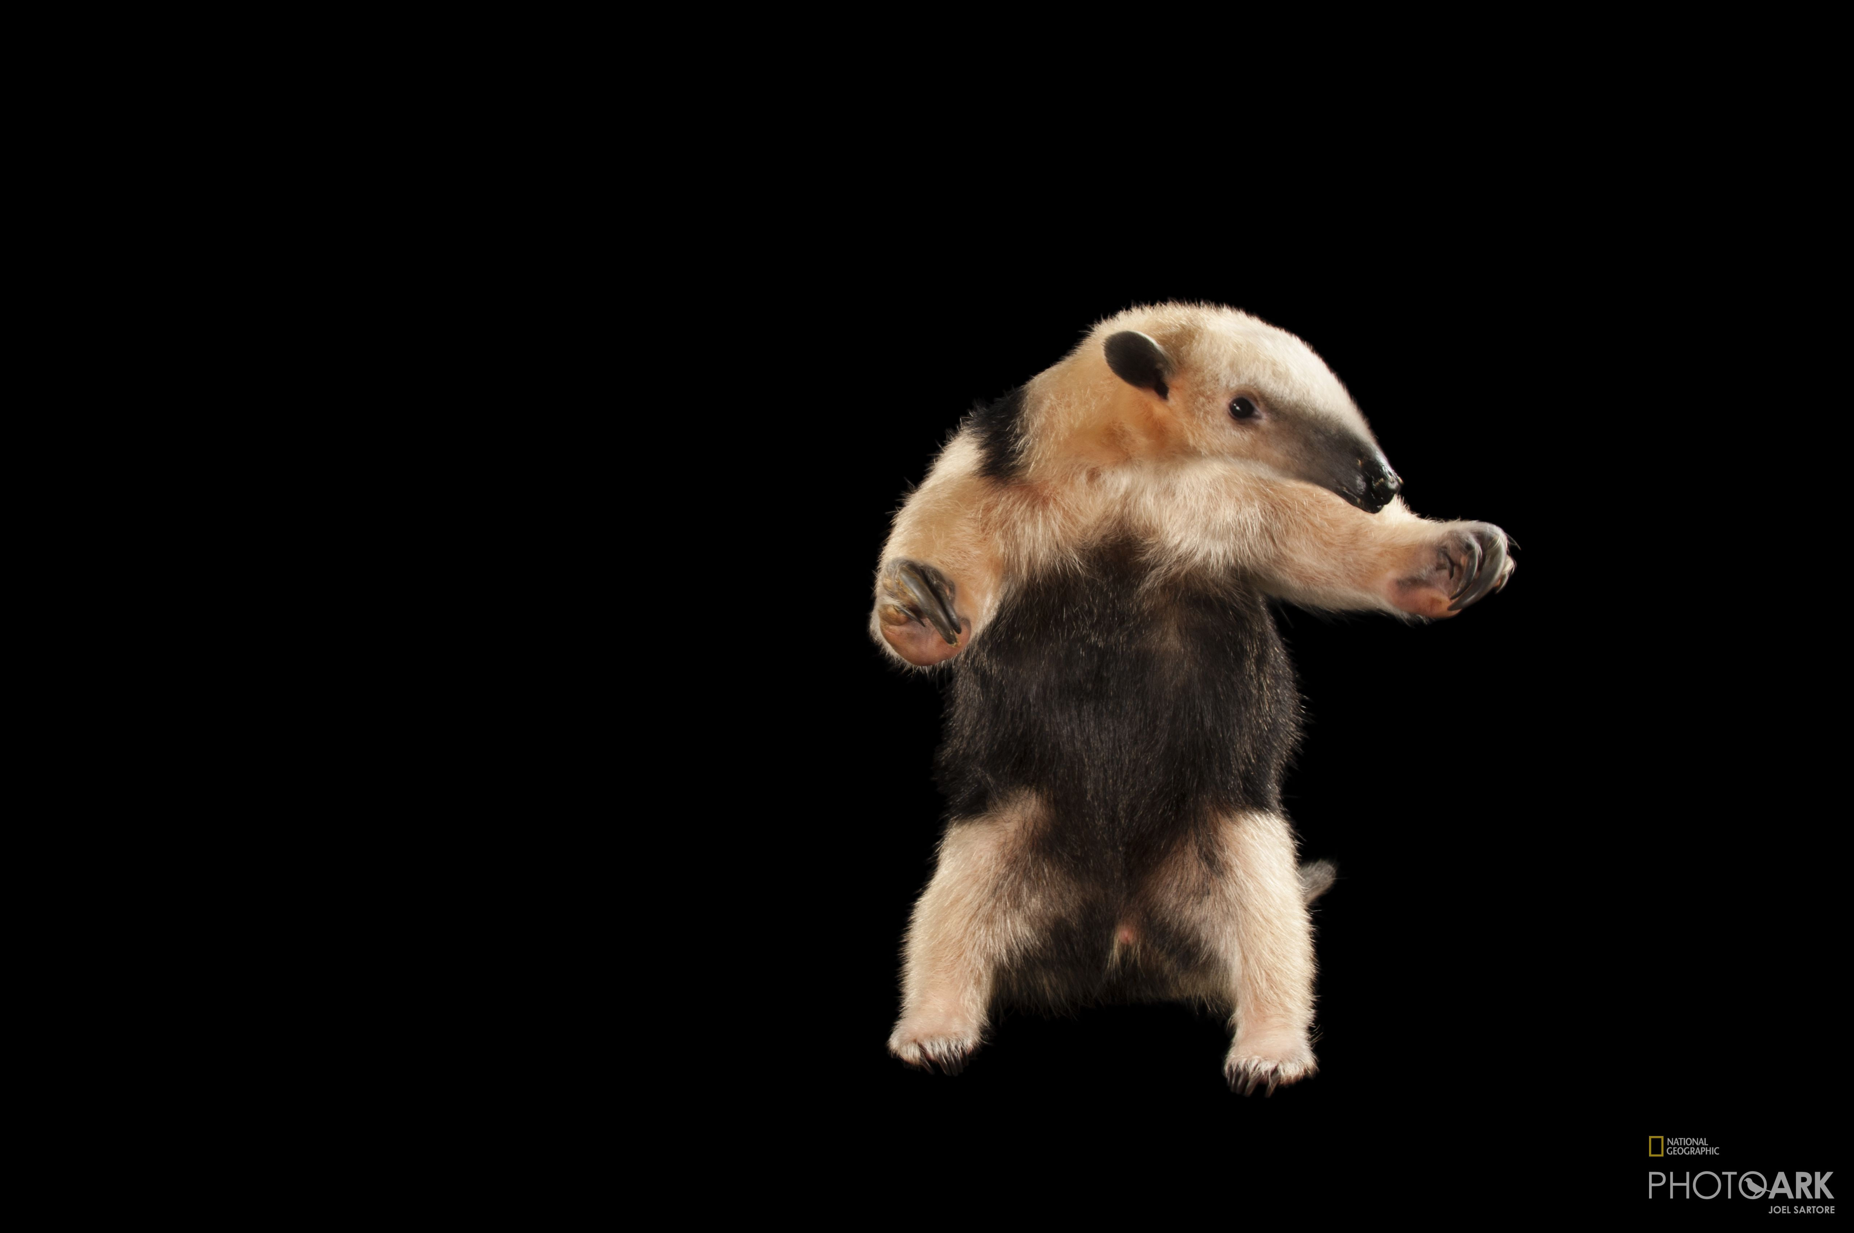
External Resources
Animalia
A-Z Animals
Wikipedia
National Geographic – Photo Ark

Slide 4
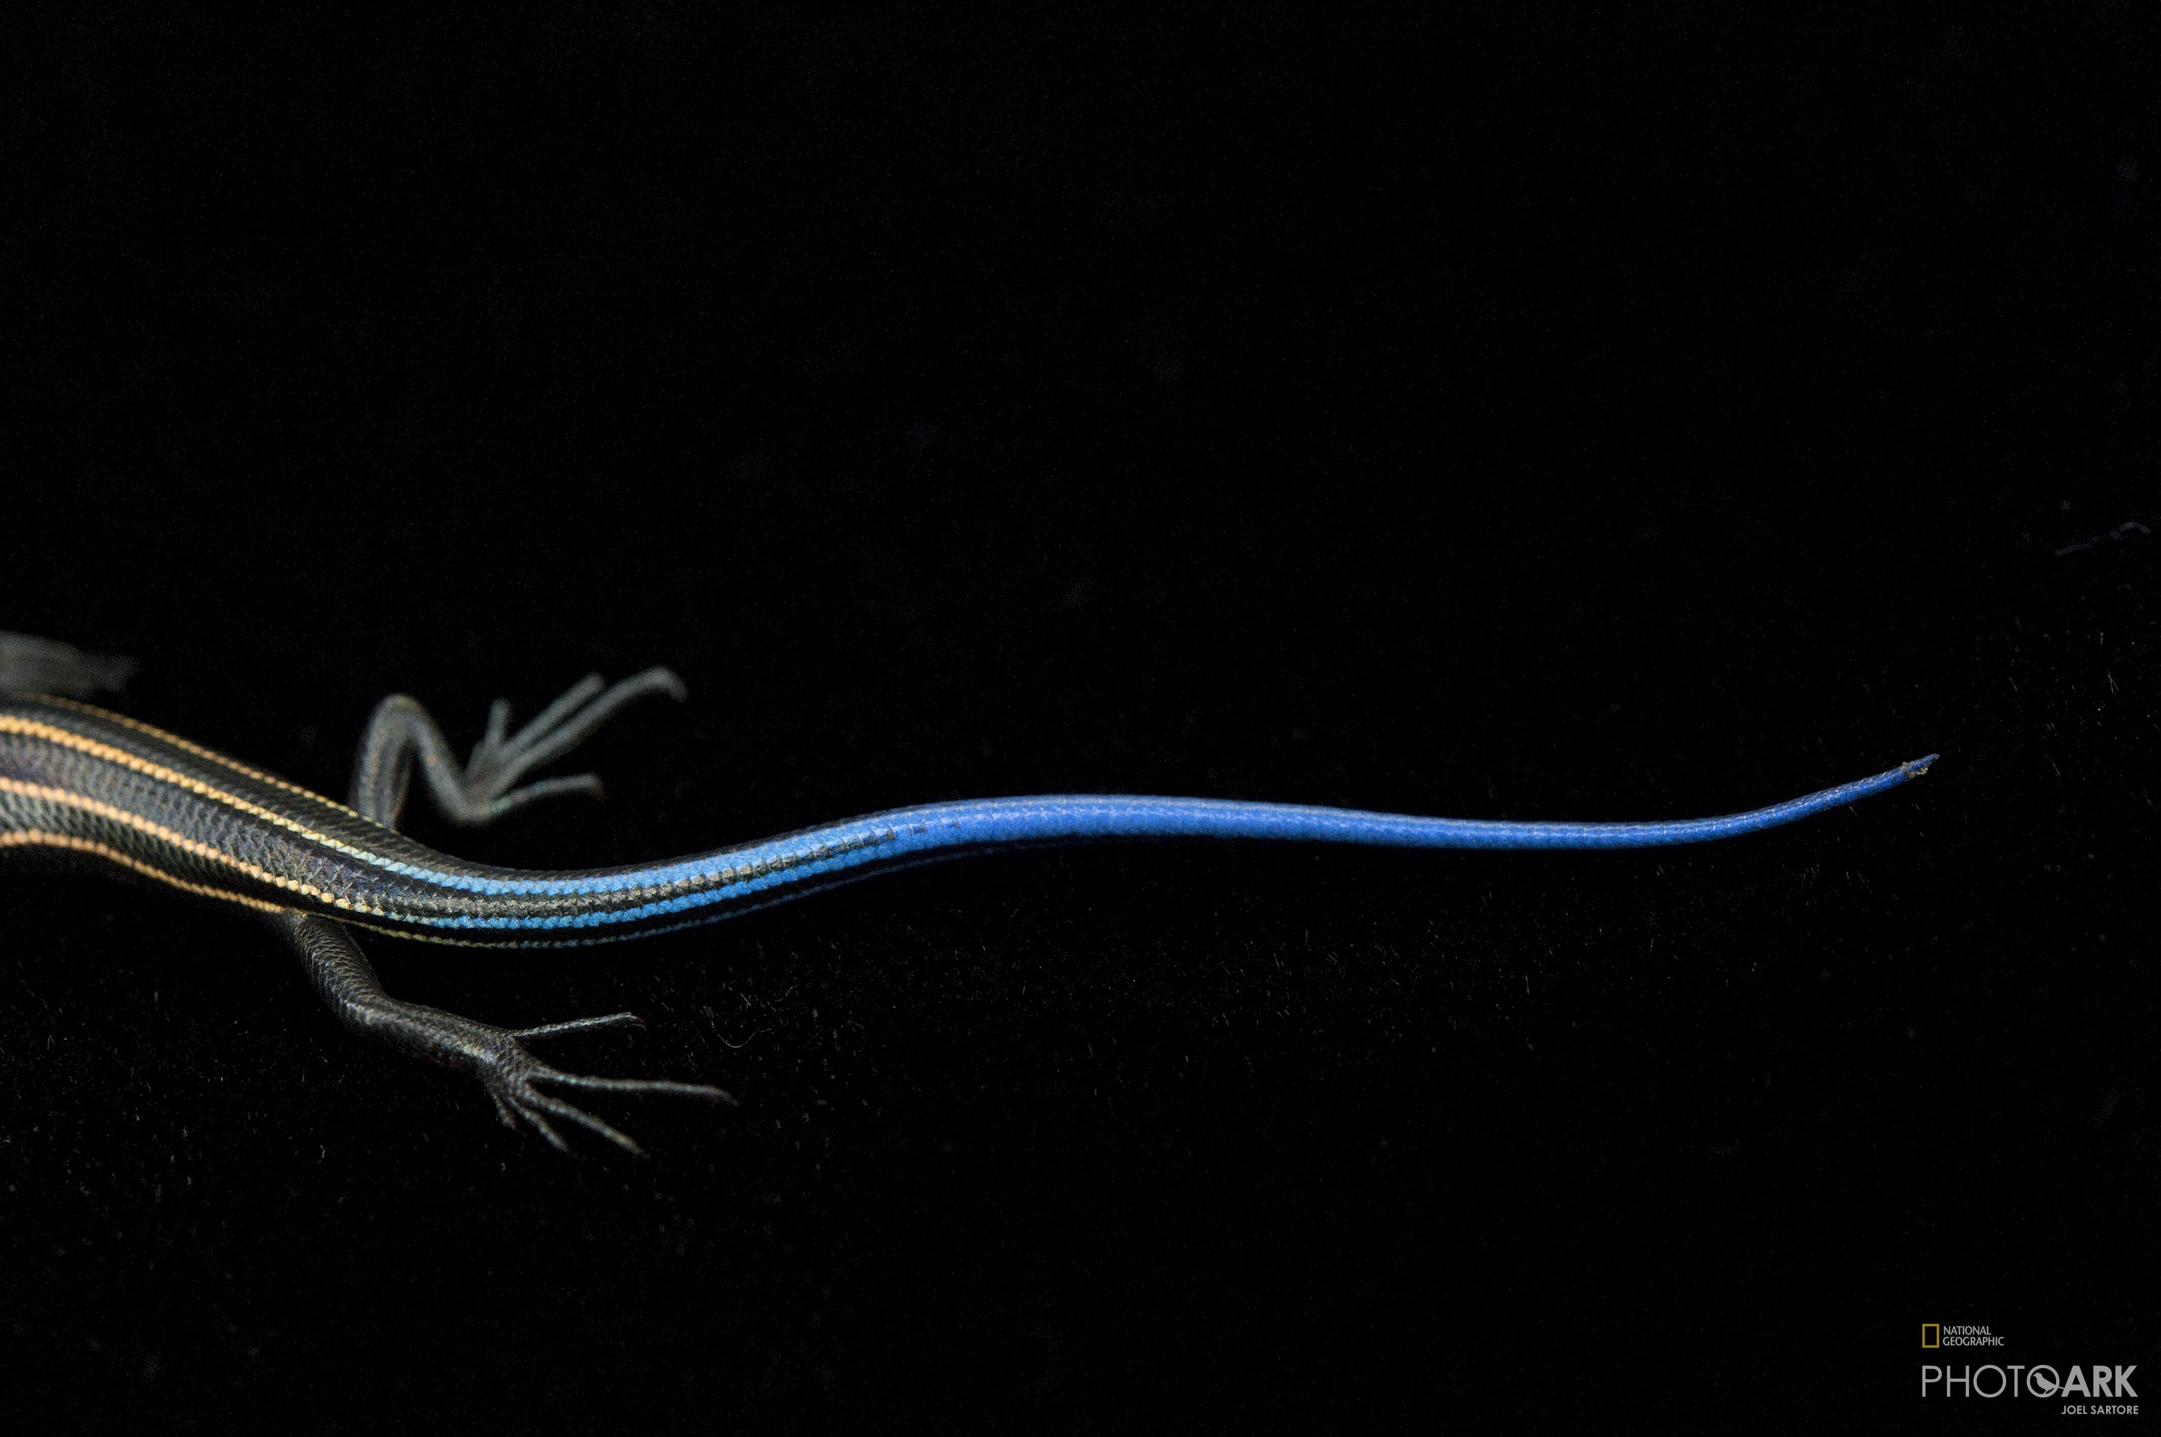
Crawling

Slide 5
Step 1
Extract all animals links from each animals’ class page (before the main website was updated) :
Mammals
Reptiles
Birds
After the process, we saved all the links into a text file.

Slide 6
Step 2
Extract all animals information from each personal page, according to specific attributes which belongs to each animal (as a strings) using Beautiful Soup. Finally, we built list of dictionary, while each dictionary contain attributes of one animal, and covert the list into a json format and than to a text file.
General: Class, Order, Family, Scientific Name, Population Size, Top Speed, Length, Life Span, Weight
Geography: Continents - Africa, Antarctica, Asia, Oceania (includes New-Zeland), Central America, Europe, North America, South America
Climates - cold, dry/desert, polar/tundra, temperate, tropical
Diet - Carnivores = [carnivore, hypercarnivore, mesopredator, piscivores, predator],
Vegetarians = [folivore, frugivore, graminivore, granivore, herbivore, nectarivore, palynivore],
Insect Eaters = [insectivores, vermivorous] ,
All Eaters = [omnivore, gumivorous]
Mating Habits :
Monogamy Animals = [Monogamy, Monogamy, Serial monogamy, Serial monogamy],
Polygamy Animals = [Polyandry, Polyandry, Polygamy, Polygamy, Polygynandry, Polygynandry, Polygyny, Polygyny],
Incubation Period / Pregnancy Duration, Baby Carrying, Independent Age
Population: Population Trend – Decreasing, Stable, Increasing
Population Status – LC, NT, VU, EN, CR, EW, EX

Slide 7
Step 3
Extract two groups of animals into two lists (by crawling both pages):
1. Social animals
2. Nocturnal animals
Those two lists will be two columns in our future data frame.
After extracting, we will convert the two lists into a json format and than to files text.
Lifestyle:
Social Behavior - SOLITARY, SOCIAL, HERDING, GENERALLY SOLITARY
Active Day Period - CREPUSCULAR, NUCTURNAL, DIURNAL

Slide 8
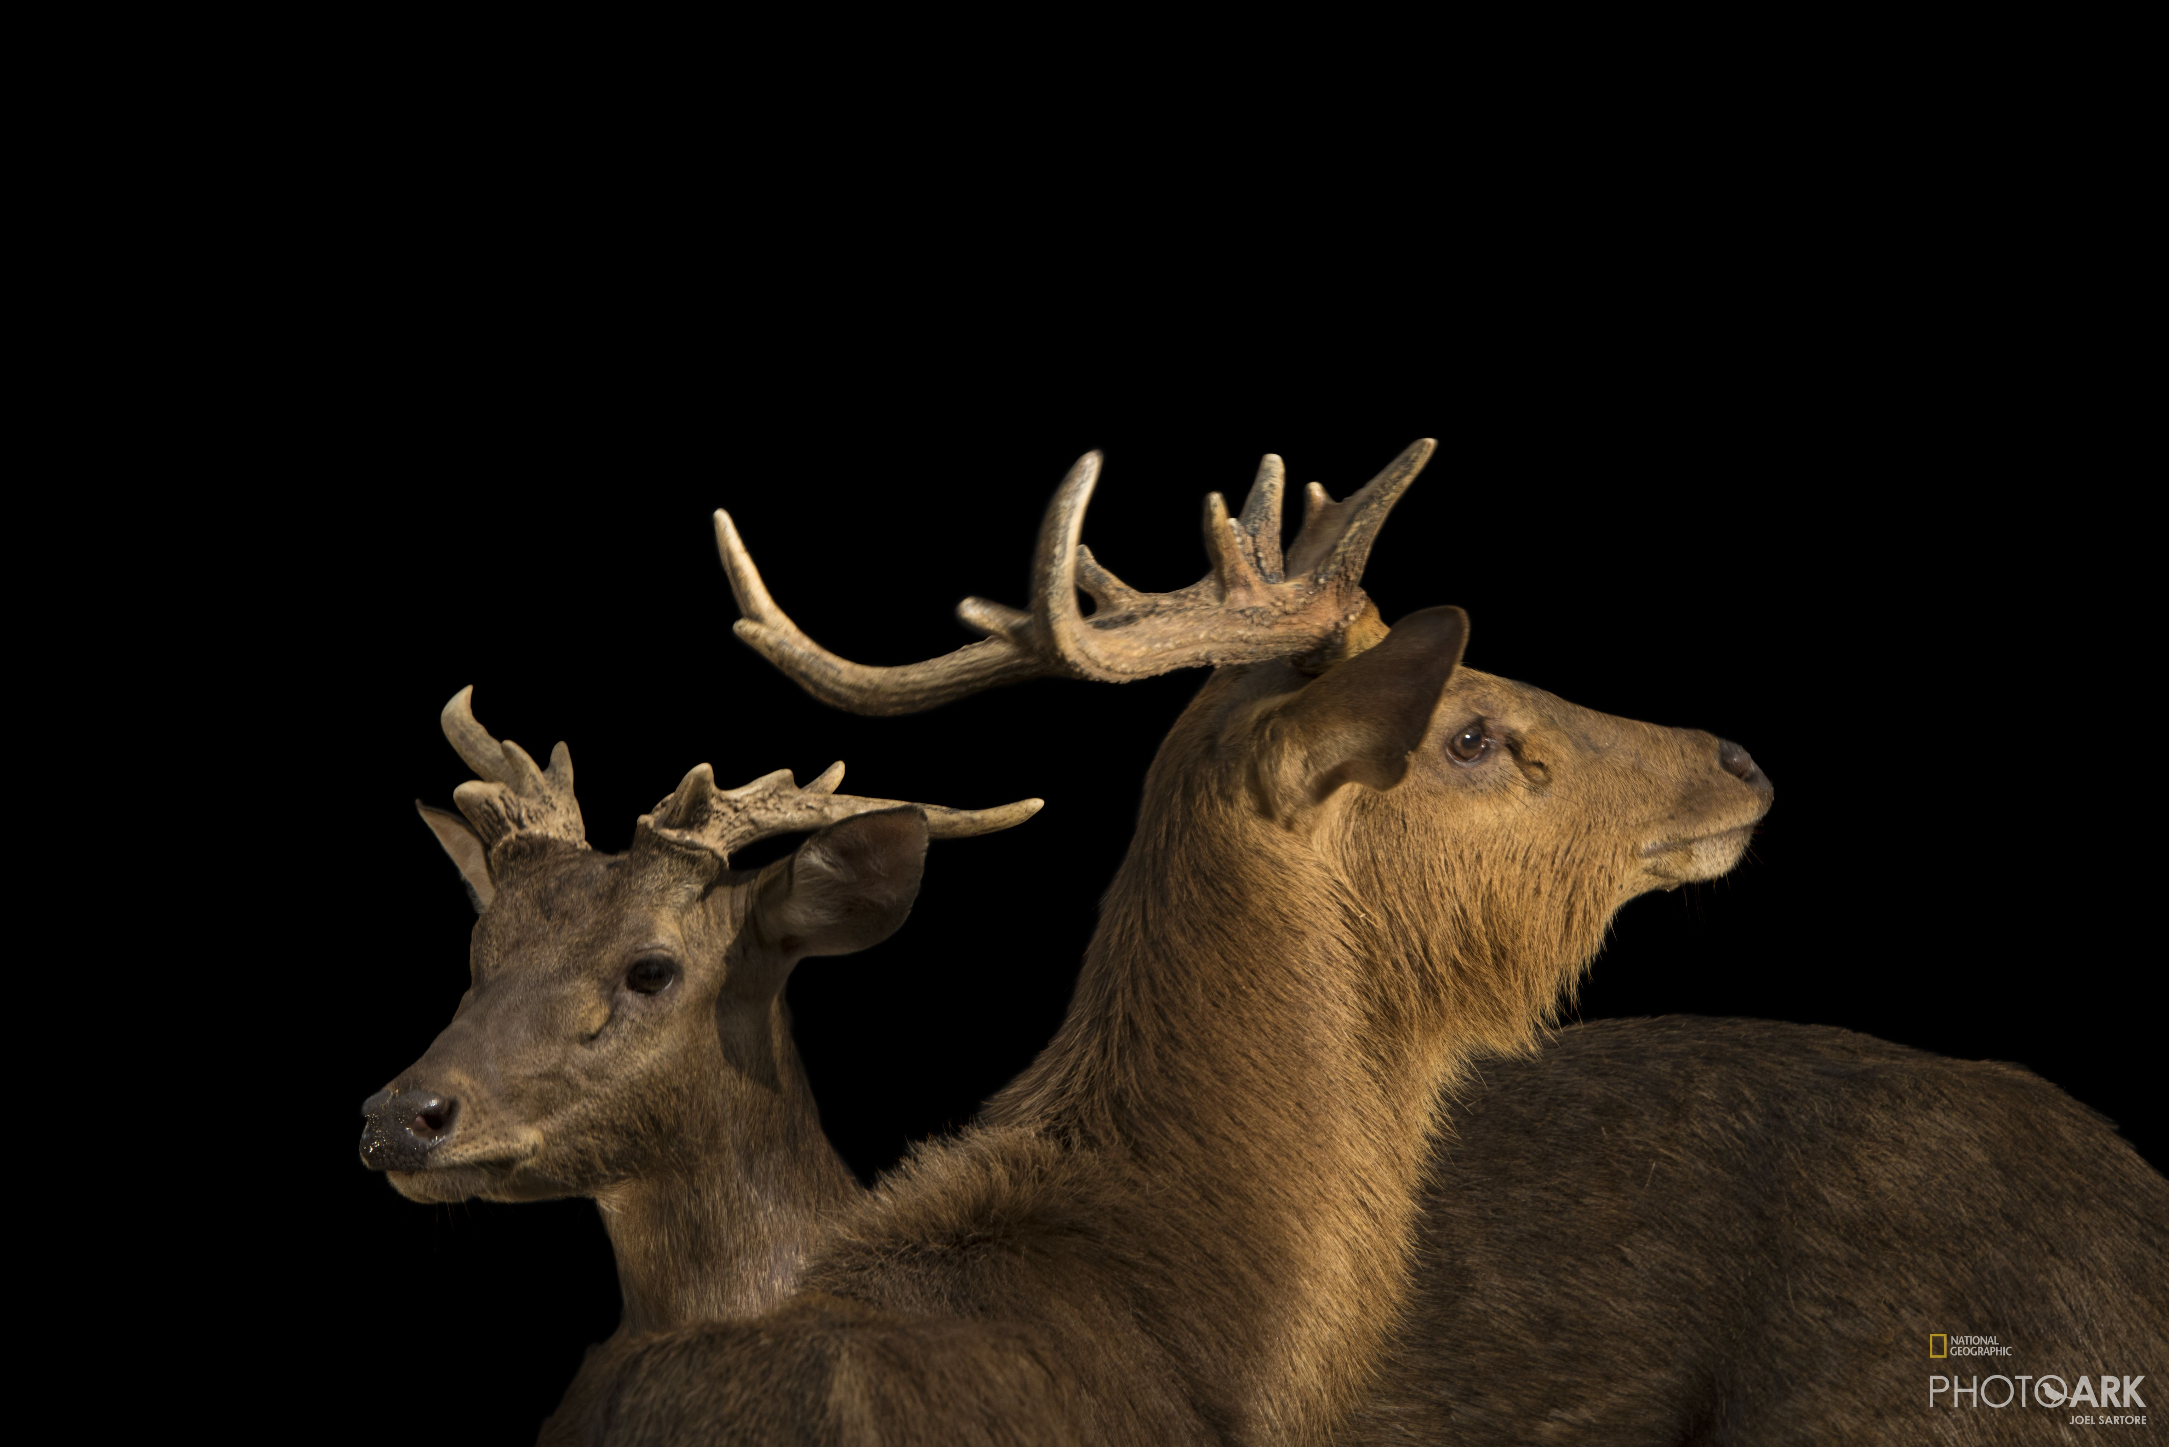
Convert json file into data frame

Slide 9
Understanding the extracted data by their data types, kinds of attributes for each feature and the number of feature we have in total for all animals.
After this stage, we created a list for each feature (our future columns), and than we had to covert all features from our json file into the right data types. All data has given by string format, so we had to convert most attributes into float and categorical data types by using regular expressions (because a lot of data has given in different shapes, so we had to extract information by this way).
In addition, data like length and weight has given by different units, so we had to convert into one represent unit.

Slide 10
Scientific name: strings
Class - 3 classes: Mammalia, Reptalia, Aves.
Order: 60 orders (strings)
Family: 252 families (strings)
Trend - 3 categories : 0 – decreasing, 1 – stable, 2 - increasing
Status - 2 categories : 0 – conserved animals, 1 - endangered
Social - 2 categories : 0 - solitary animals, 1 - social animals
Nocturnal - 2 categories : 0 - day active animals, 1 - nocturnal animals
Diet - 4 categories: 0 - all eaters (meats, vegtables, insects ect.), 1 – carnivores, 2 – vegetarians, 3 - insects eaters, 4 - scavengers
Mating behavior - 2 categories: 0 - monogamy animals (dyadic relationship),
1 - polygamy animals (multiple spouses)
Continuous variable : Life Span (by years), Length (by cm), Weight (by kg), Baby Carrying,
Incubation Period (days) , Independent Age (by days)
Continents columns (binomial columns): Africa, Antarctica, Asia, Oceania (includes New-Zeland), Central America, Europe, North America, South America.
Climate zones (binomial columns): cold, dry/desert, polar/tundra, temperate, tropical.
Our Data Frame
(in total 1589 animals)

Slide 11

Handling Missing Data

Slide 12
Part 1
Step 1: Understanding the data: Data Types, missing data, mean, unique, frequency, count, etc.
Step 2: We found missing data at Status feature and we filled it manually (using external resources).
About the animals we have not found their Status at external resources, we had to drop them from our data frame.
Part 2
Step 1: Filling missing data for the continuous variables by mean.
Step 2: Filling missing data for “Mating Behavior” variables by mode (categorical).
Finally, our data includes 1548 animals.

Slide 13
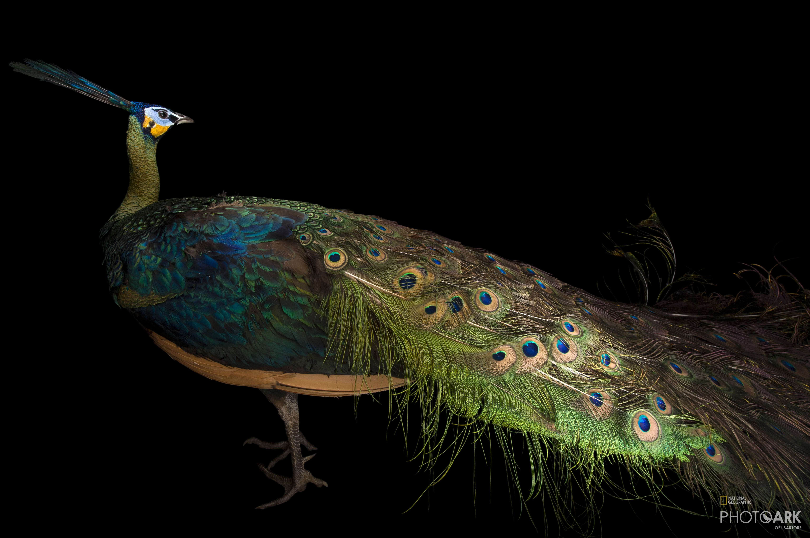
Visualizations

Slide 14
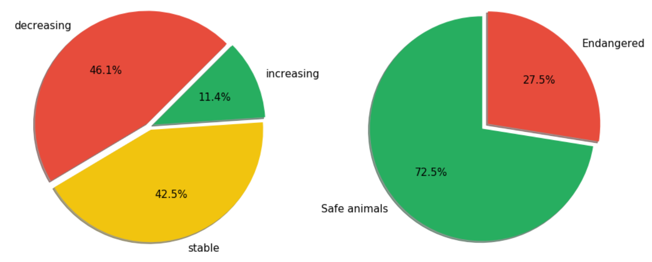
Trend pie chart
Status pie chart

Slide 15
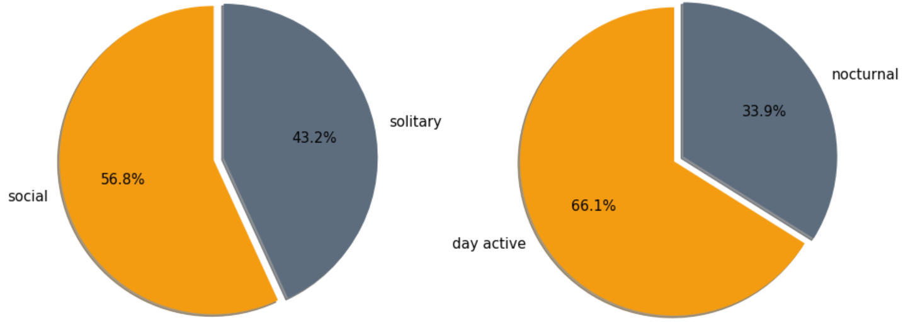
Day active vs Nocturnal
animals
Social vs Solitary animals

Slide 16
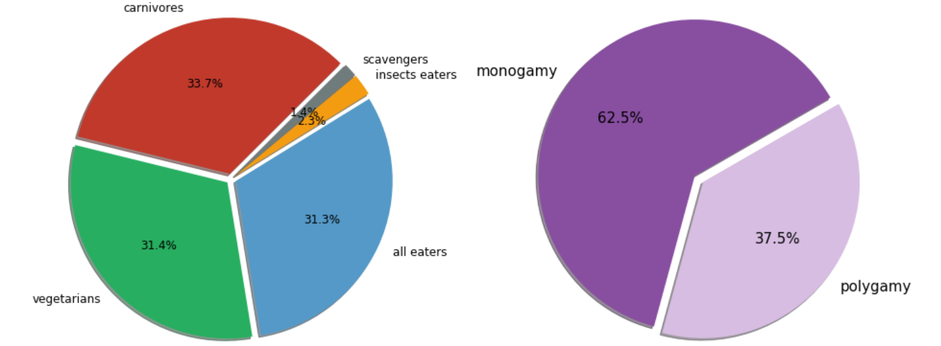
Diet pie chart
Mating Behavior pie chart

Slide 17
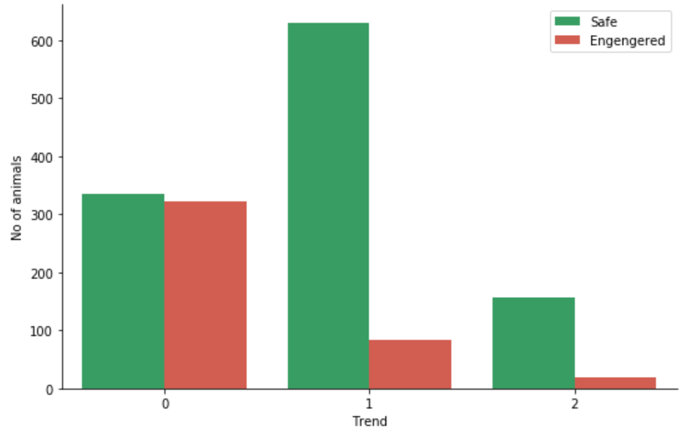
The correlation between the Status (0 - safe, 1 - endangered) and
Trend (0 - decreasing, 1 - stable, 2 - increasing) variables:
As we can see, there is a strong relationship between safe animals and stable and increasing trends.
Also we can see visible bond between endangered animals and the decreasing trend (compared with the other trends).

Slide 18
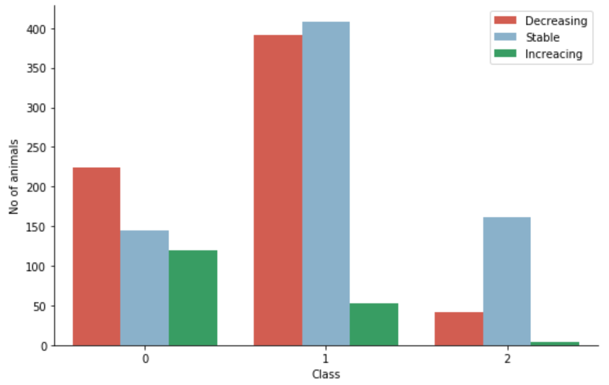
The correlation between the animal’s Class (0 - Birds, 1 - Mammals, 2 - Reptiles) and Trend (0 - decreasing, 1 - stable, 2 - increasing) variables:
We can see that animals' trend condition are not very good, because most of animals are or in decreasing or in stable trend (but not in increasing).
The worst ratio between the decreasing and increasing trends is in the Mammalia class.

Slide 19
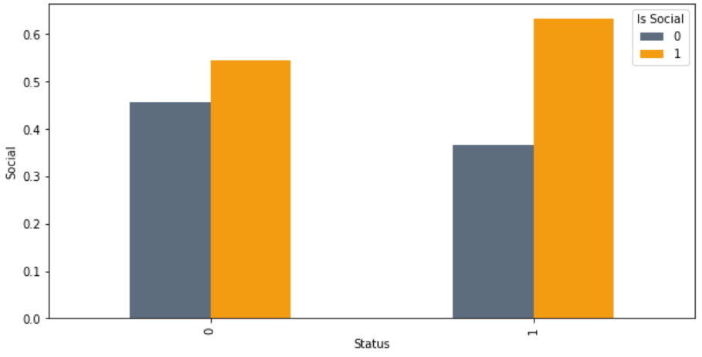
The correlation between the Status (0 - safe, 1 - endangered) and Social animals (0 - solitary, 1 - social) variables:
As we can see, social animals are more in danger than solitary
animals, that could be because they are more "naive" - are not seem to afraid from other species.

Slide 20
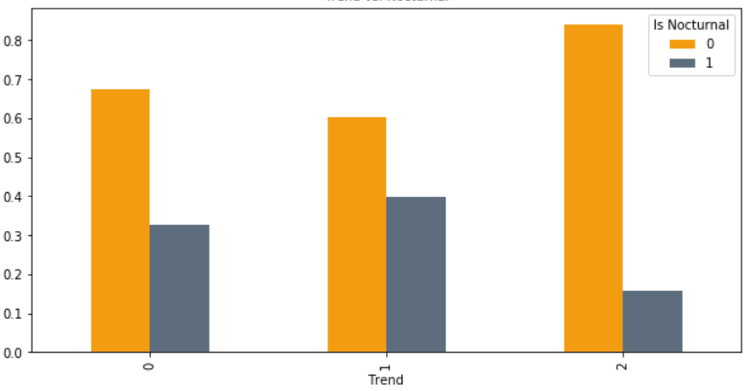
The correlation between the Trend (0 - decreasing, 1 - stable, 2 - increasing) and Nocturnal (0 - diurnal, 1 - nocturnal) variables:
As we can see, the correlation between day active animals and all trends values stronger than between nocturnal animals (maybe it is because of the fact that nocturnal animals are more hidden). The highest correlation is between
day active animals and the increasing trend, that is could be because in light period of the day, it is more simple to be aware to the surrounding area and to escape from danger.

Slide 21
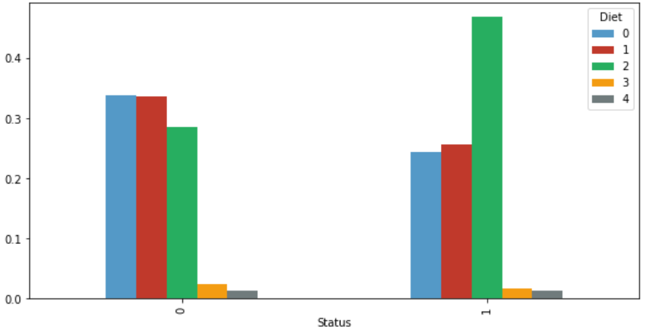
The correlation between the Status (0 - safe, 1 - endangered) and Diet (0 - all eaters, 1 - carnivores, 2 - vegetarians, 3 - insects eaters, 4 - scavengers) variables:
The strongest correlation is between the vegetarians and endangered animals. That could be because of the damage to the environment (caused by humans).

Slide 22
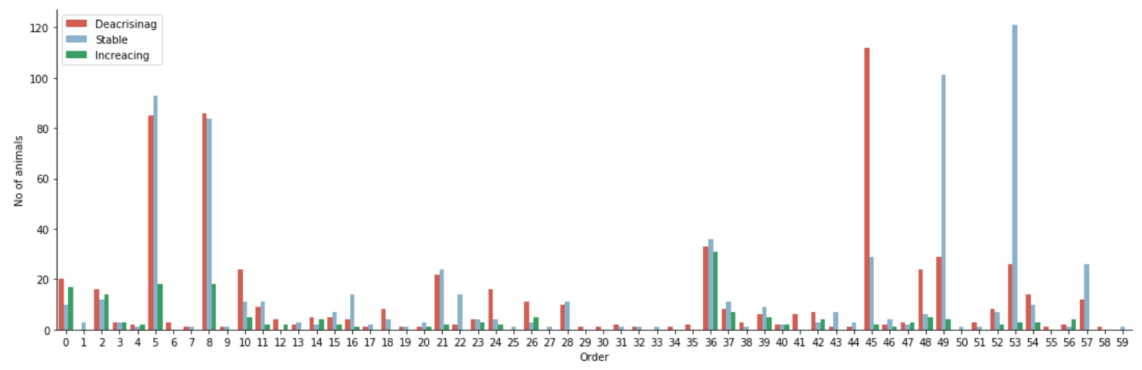
Focus on specific Orders:
We checked the Trend in relation to Orders. We extracted the most badly-affected populations into new data frame.

Slide 23
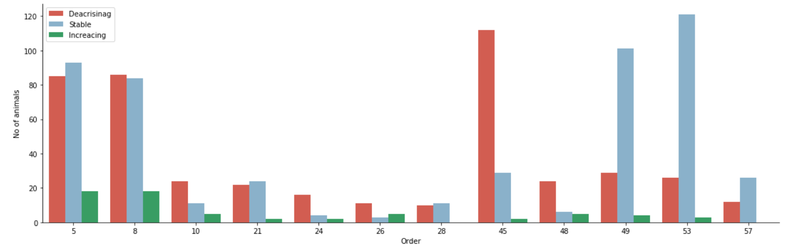
CARNIVORA (wolves, cats, foxes)
DIPROTODONTIA (Kangaroo, mouses, Koala)
PRIMATES (monkeys, Lemurs)
RODENTIA (Squirrel, Hamsters)
GRUIFORMES (crane birds)
TESTUDINES (turtles)
ARTIODACTYLA (deers, pigs, whales)
CHARADRIIFORMES (kind of bird)
GALLIFORMES (chickens, peafowl)
SQUAMATA (snakes and Iguana)
LAGOMORPHA (rabbits)
PSITTACIFORMES (parrot)

Slide 24
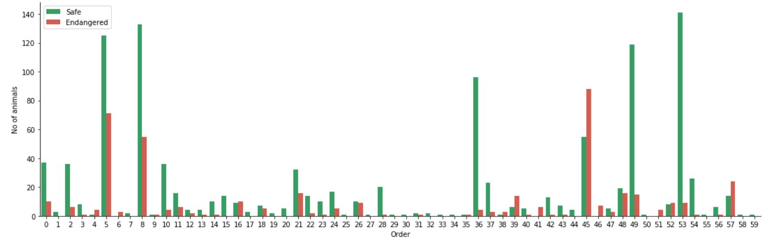
Also we checked the Status in relation to Orders.

Slide 25
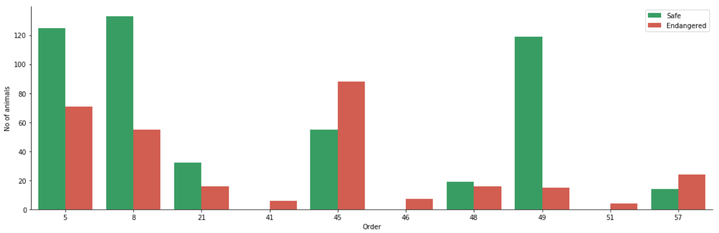
CARNIVORA (wolves, cats, foxes)
RODENTIA (Squirrel, Hamsters)
TESTUDINES (turtles)
PHOLIDOTA (pangolin)
PROBOSCIDEA (elephant)
ARTIODACTYLA (deers, pigs, whales)
DIPROTODONTIA (Kangaroo, mouses, Koala)
PRIMATES (monkeys, Lemurs)
PSITTACIFORMES (parrot)
SIRENIA (sea cows)

Slide 26
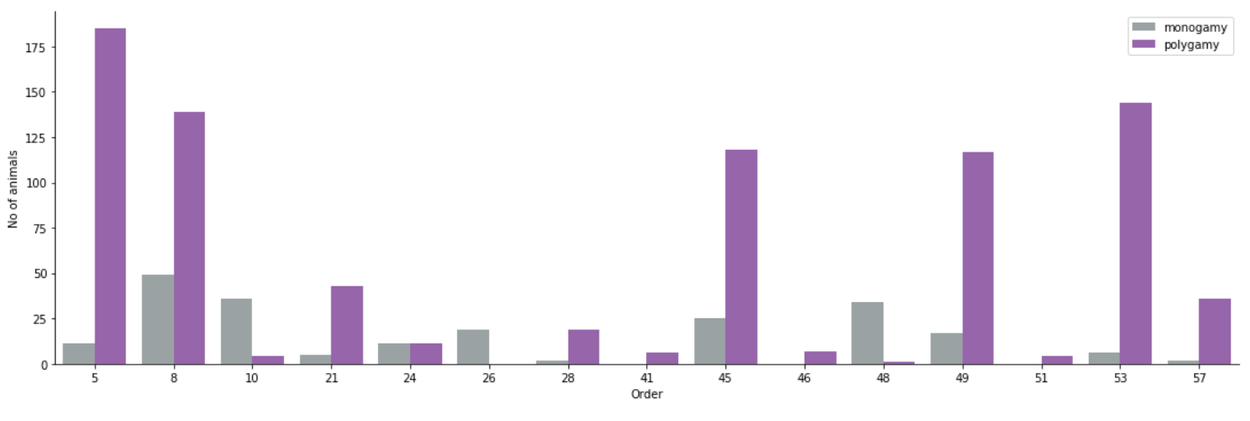
Number of animals according to their Order (the specific Orders we found before) dividing by Mating Behavior categories (0 - monogamy, 1 - polygamy) :
We can see that polygamy animals are more endangered than monogamy animals.

Slide 27
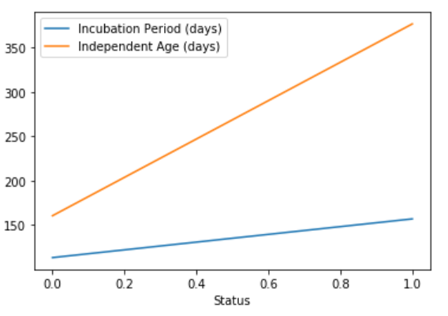
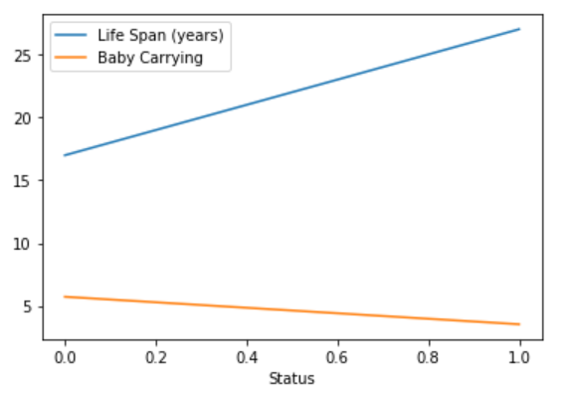
We can see, as the incubation period, the independent age and the life span are higher, then the probability to be endangered is higher.
Also, the probability higher as the number of babies is smaller.

Slide 28
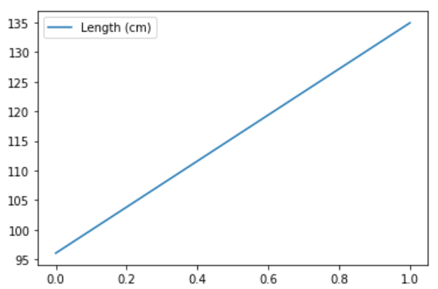
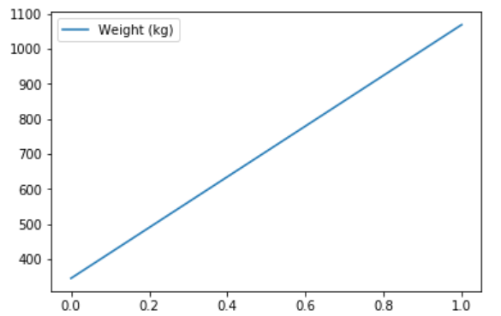
We also can see that the larger the animal is, the greater its probability of being endangered.

Slide 29
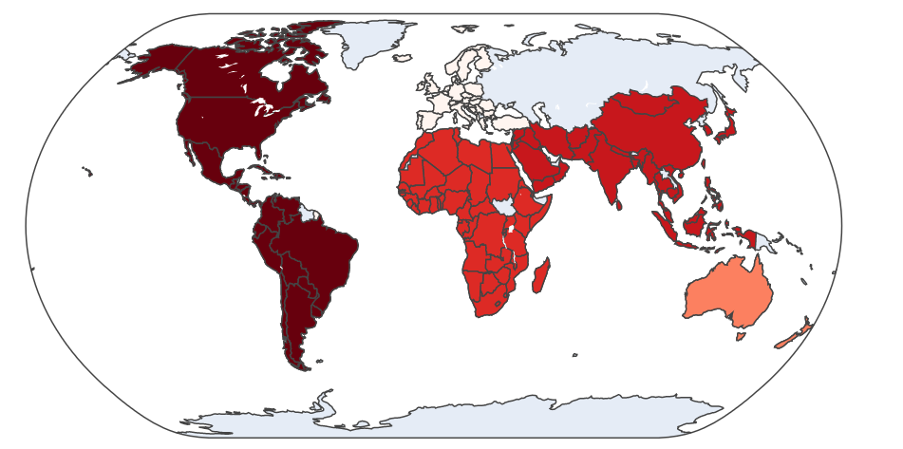
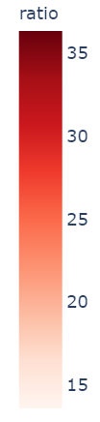
There we can see the ratio between the number of endangered and conserved animals on each continent (in our data, Russia belongs to Asia and in Antarctica the ratio 26).
The ratio means the percentage of animals at risk relative to all known species on the same continent.

Slide 30
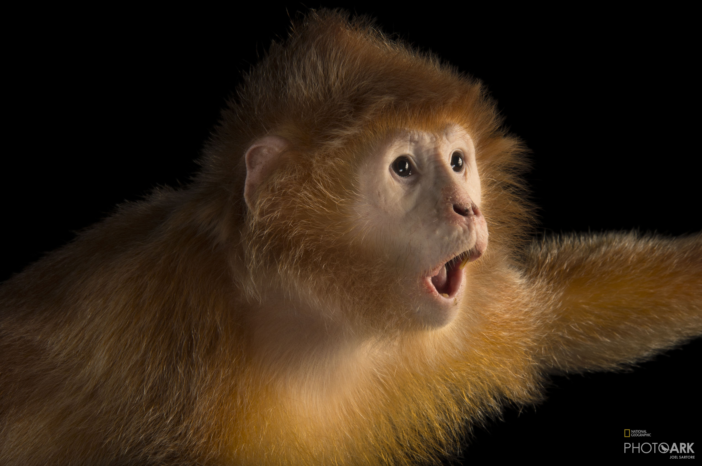
Machine Learning

Slide 31
Our label is “Status” column, because our research question refer to if a species is endangered or conserved .
We chose to apply Logistic Regression – Supervised Learning for classification problems – categorical label.
Before the feature engineering stage, we got accuracy of 67%.
Our final model accuracy is 80% .

Slide 32
Step 1: We dropped family column from our data frame, because his variable is string type.
Step 2: We applied machine learning process:
Dividing our data frame: features and label (status).
Dividing features and label to train and test (train = 0.8, test = 0.2).
Fit & Predict
Accuracy
Step 3: Feature Engineering:
We found out the “Pearson Correlation” between all features.
We dropped the continents’ columns.
We merged all climate columns into one column.
We created new columns by multiplying features:
Incubation period & Life Span, Independent Age & Baby Carrying
Then, we dropped Incubation period, Life Span, Independent Age, Baby Carrying columns.

